Slide 1


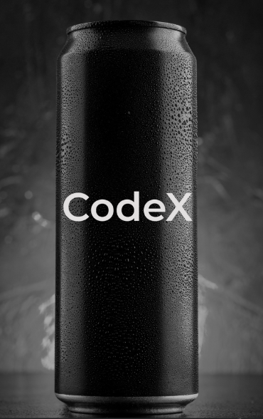
Marketing Insights For CodeX
Codebasics Resume Project
Challenge - 6

Slide 2
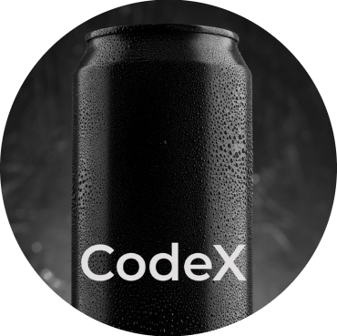

Content
Company Overview
Goals
Problem Statement
Primary & Secondary Insights
Recommendations

Slide 3
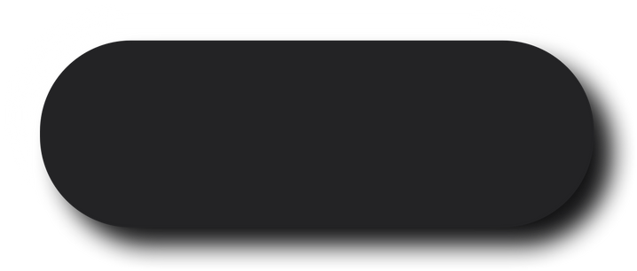
Company Overview
CodeX is a German beverage company that is aiming to make its mark in the Indian market. A few months ago, they launched their energy drink in 10 cities in India.
Their Marketing team is responsible for increasing brand awareness, market share, and product development. They conducted a survey in those 10 cities and received results from 10k respondents.

Slide 4



Goals
Increase Brand Awareness
Increase Market Share
Product Development

Slide 5
Objective
As a marketing data analyst my task is to create a dashboard for the marketing team to convert these survey results into meaningful insights
which can be used to drive actions and help in better and deeper understanding of the market.

Slide 6
-> The Indian energy drink market has experienced significant growth in recent years, driven by changing lifestyles, increasing urbanization, and a growing young population.
-> According to industry reports, the market size is estimated to be worth over $1 billion, with a compound annual growth rate (CAGR) of around 15-20%.
-> Red Bull holds a dominant position in the Indian market, followed by Monster Energy and other local brands.
-> Caffeine content is closely monitored by FSSAI, and brands must comply with maximum permissible limits set by the regulatory authority.
Market Analysis

Slide 7

Primary Insights
Demographic Insights
Consumer Preferences
Competition Analysis
Marketing Channels and Brand Awareness
Brand Penetration
Purchase Behavior
Product Development

Slide 8

Demographic Insights
Who prefers energy drink more?
b. Which age group prefers energy drinks more?
c. Which type of marketing reaches the most Youth (15-30)?

Slide 9
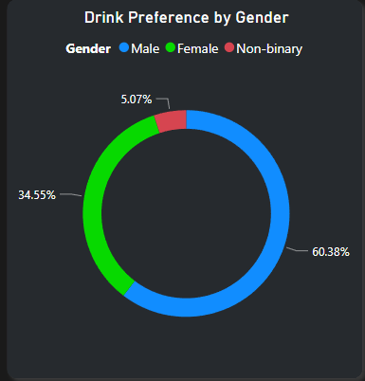
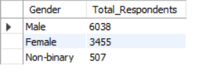
a.Who prefers energy drink more?
Males preferred more energy drink i.e. 60.38% among all genders.
Energy drink marketing often targets young men with images of extreme sports, adventure, and high-energy lifestyles. These advertisements might resonate more strongly with men, leading to higher consumption rates.

Slide 10
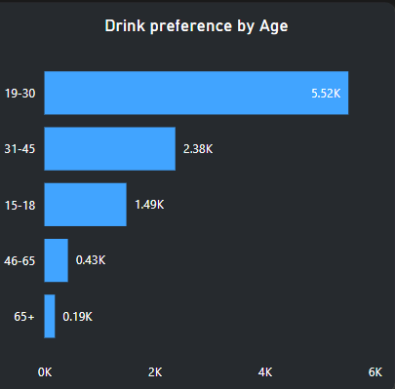
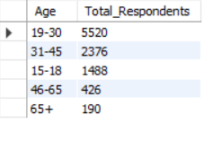
b.Which age group prefers energy drinks more?
19-30 age group consumes maximum energy drink followed by 31-45.
Energy drink marketing often targets young men with images of extreme sports, adventure, and high-energy lifestyles. These advertisements might resonate more strongly with men, leading to higher consumption rates.

Slide 11
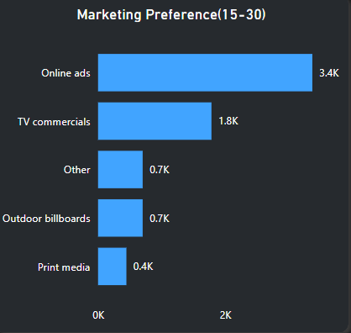
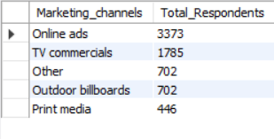
c.Which type of marketing reaches the most Youth
(15-30)?
Online Platforms like Instagram, Snapchat, TikTok, and YouTube are highly popular among young people. Marketing campaigns that leverage engaging content, influencers, and interactive features on these platforms can effectively reach audiences between 15-30 age group.

Slide 12

Consumer Preferences
a. What are the preferred ingredients of energy drinks among respondents?
b. What packaging preferences do respondents have for energy drinks?

Slide 13
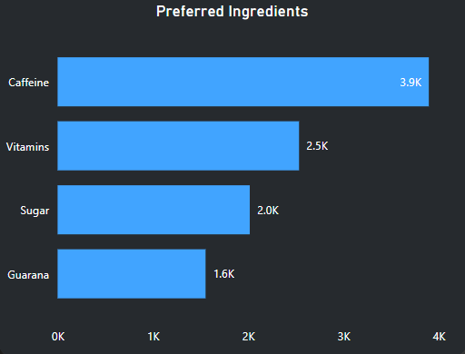
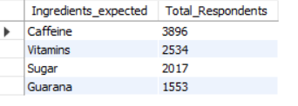
a. What are the preferred ingredients of energy drinks among respondents?
Caffeine is a central nervous system stimulant that can increase alertness, concentration, and energy levels. Many people consume energy drinks specifically for this stimulating effect, especially when they need to stay awake or focused for an extended period.

Slide 14
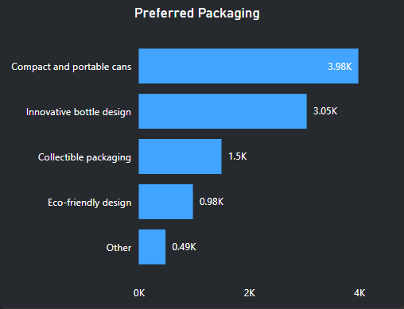
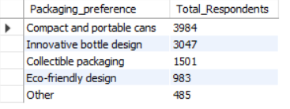
b. What packaging preferences do respondents have for energy drinks?
Compact cans are easier to carry and handle, making them convenient for consumers who are on the go. They can be easily stored in backpacks, purses, or pockets, allowing consumers to enjoy their beverages wherever they are.

Slide 15

Competition Analysis
Who are the current market leaders?
b. What are the primary reasons consumers prefer those brands over ours?

Slide 16
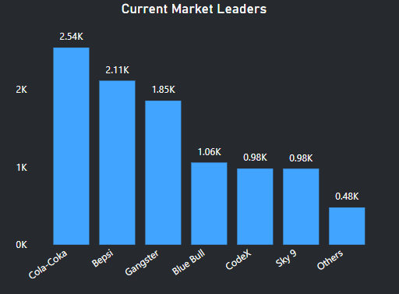
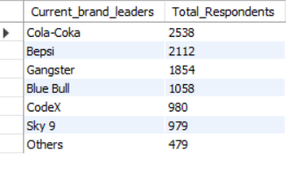
Who are the current market leaders?
Top 3 market leaders are- Cola-Coka, Bepsi, Gangster.
CodeX’s immediate competitor is Sky 9 and Blue Bull.

Slide 17
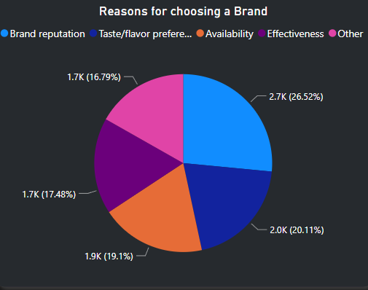
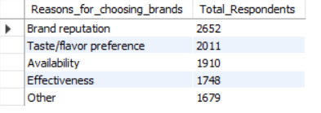
b. What are the primary reasons consumers prefer those brands over ours?
Brand Reputation & Taste/flavor preference are primary reasons consumers prefer those brands over ours.

Slide 18

Marketing Channels and Brand Awareness
Which marketing channel can be used to reach more customers?
How effective are different marketing strategies and channels in reaching our customers?

Slide 19
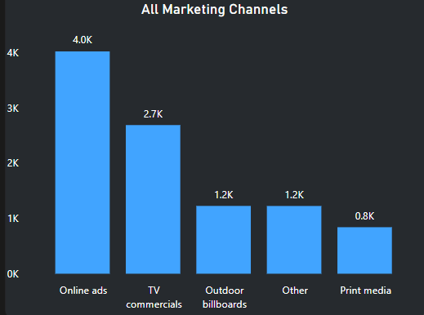
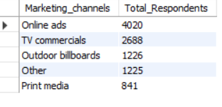
Which marketing channel can be used to reach more customers?
Online ads and TV commercials are more reachable due to their wide reach and ability to deliver engaging content.

Slide 20
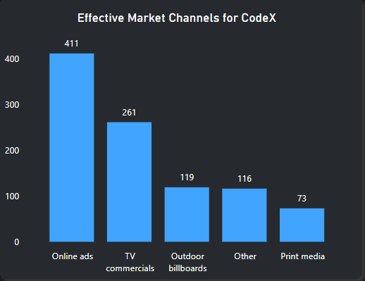
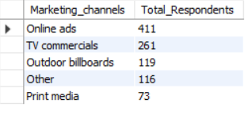
b.How effective are different marketing strategies and channels in reaching our customers?
Online ads and TV commercials are more reachable due to their wide reach and ability to deliver engaging content.

Slide 21
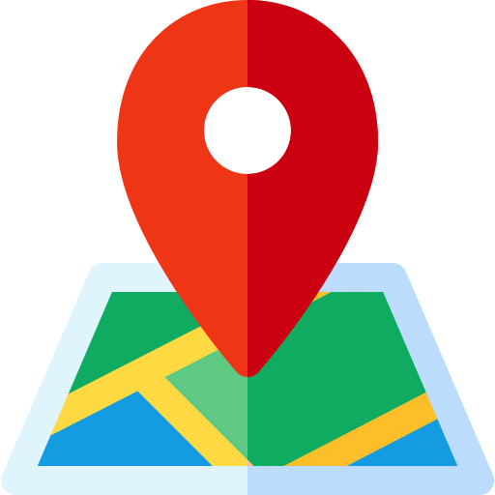
Brand Penetration
a. What do people think about our brand? (overall rating)
b. Which cities do we need to focus more on?

Slide 22
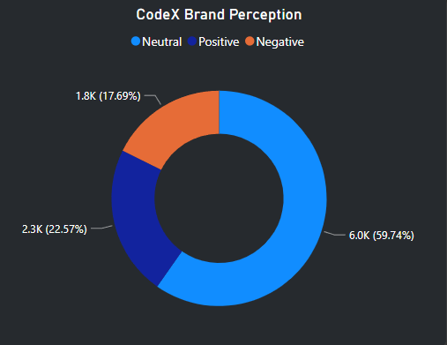

a. What do people think about our brand? (overall rating)
60% people give neutral, 22% people give positive and 17% people gives negative ratings towards our brand.
Brand perception is the collective impressions, beliefs, and emotions that consumers associate with a brand, shaping their attitudes and behaviors.

Slide 23
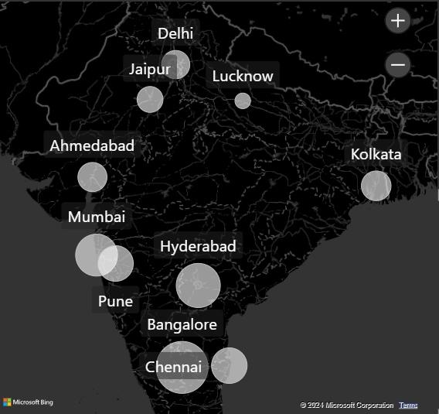
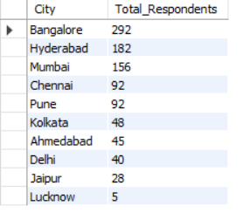
b. Which cities do we need to focus more on?
In tier-1, Banglore and Hyderabad is doing good. In tier-2, Pune and Kolkata are doing good.
We need to focus on Delhi in tier-1 and Jaipur, Lucknow in tier-2.

Slide 24

Purchase Behavior
a. Where do respondents prefer to purchase energy drinks?
b. What are the typical consumption situations for energy drinks among respondents?
c. What factors influence respondents' purchase decisions, such as price range and limited edition packaging?

Slide 25
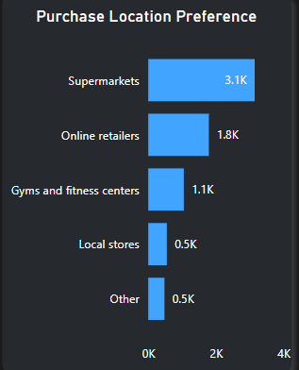
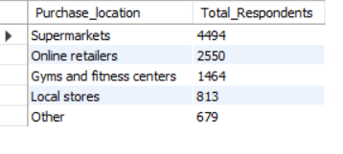
a. Where do respondents prefer to purchase energy drinks?
Supermarkets are preferred by 45% of respondents followed by online retailers by 25% of respondents.

Slide 26
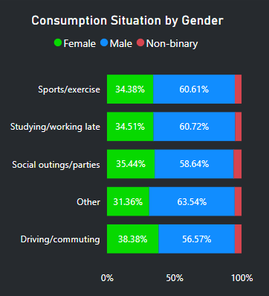
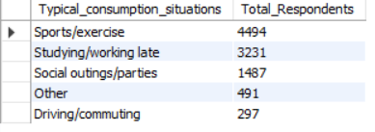
b. What are the typical consumption situations for energy drinks among respondents?
45% of respondents say they typically consume energy drinks before/after Sports/exercise

Slide 27
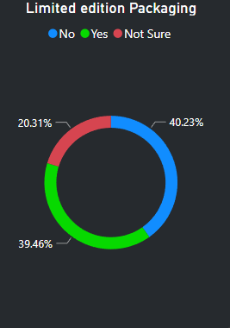
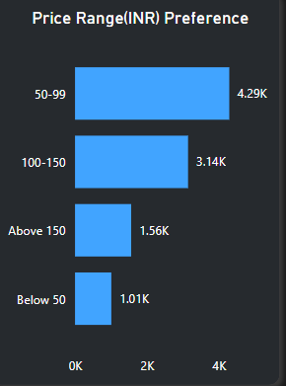
c. What factors influence respondents' purchase decisions, such as price range and limited edition packaging?
43% of respondents prefer Price range between 50-99.

Slide 28

Product Development
Which area of business should we focus more on our product development? (Branding/taste/availability)

Slide 29
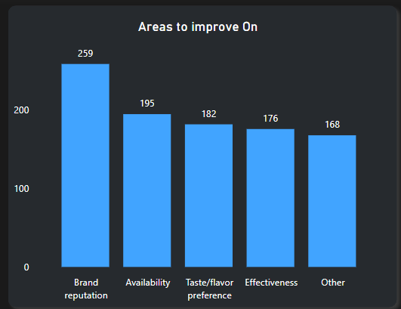
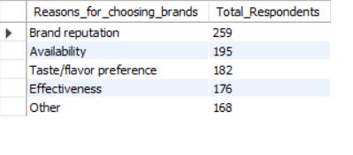
a.Which area of business should we focus more on our product development? (Branding/taste/availability)
We need to focus more on brand effectiveness and taste/flavor preferences.

Slide 30
Secondary Insights
These insights can be derived from additional market research and information provided in the datasets.

Slide 31
35% of respondents say Increased energy and focus is the main reason for consuming our product they consume our product 2-3 times a week.
25% of respondents say Unavailability is the reason for not trying our product.
22% of respondents say they are not trying our product due to possible health concerns.
34% of respondents say they consume our energy drink during office working ours and study hours to stay awake.
only 5% of respondents vs 11% for cola-coka which is the leading brand in india have heard us before the survey.
Average rating for our product is 3.2

Slide 32
5 recommendations for CodeX
● What immediate improvements can we bring to the product?
● What should be the ideal price of our product?
● What kind of marketing campaigns, offers, and discounts we can run?
● Who can be a brand ambassador, and why?
● Who should be our target audience, and why?

Slide 33
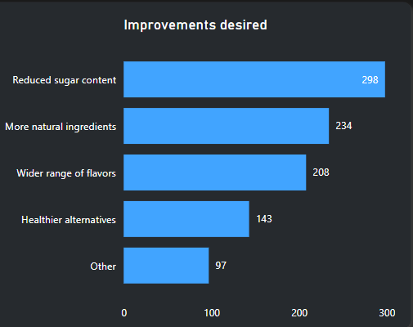
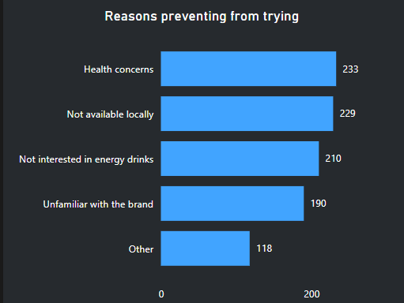
What immediate improvements can we bring to the product?
Reduced sugar content can be beneficial for health-conscious customers as 30% of our customers wanted less sugar content in energy drinks.
Add more natural ingredients like caffeine, vitamin B and promote our energy drink as a healthy and natural.
Work upon availability of our product in every supermarket and retail store near gyms, late night clubs and in office canteens.

Slide 34
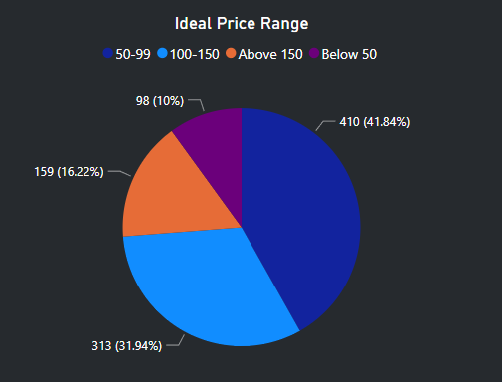
What should be the ideal price of our product?
The price within the range of 50-99 Rupees is the best choice for our product without compromising quality, affordability, brand reputation.
85 Rupees would probably satisfy most customers.

Slide 35
What kind of marketing campaigns, offers, and discounts we can run?
Influencer Partnerships
Contests and Giveaways:
Sampling Programs
Subscription Programs
Cross-Promotions
Loyalty Rewards
Limited-Time Offers

Slide 36
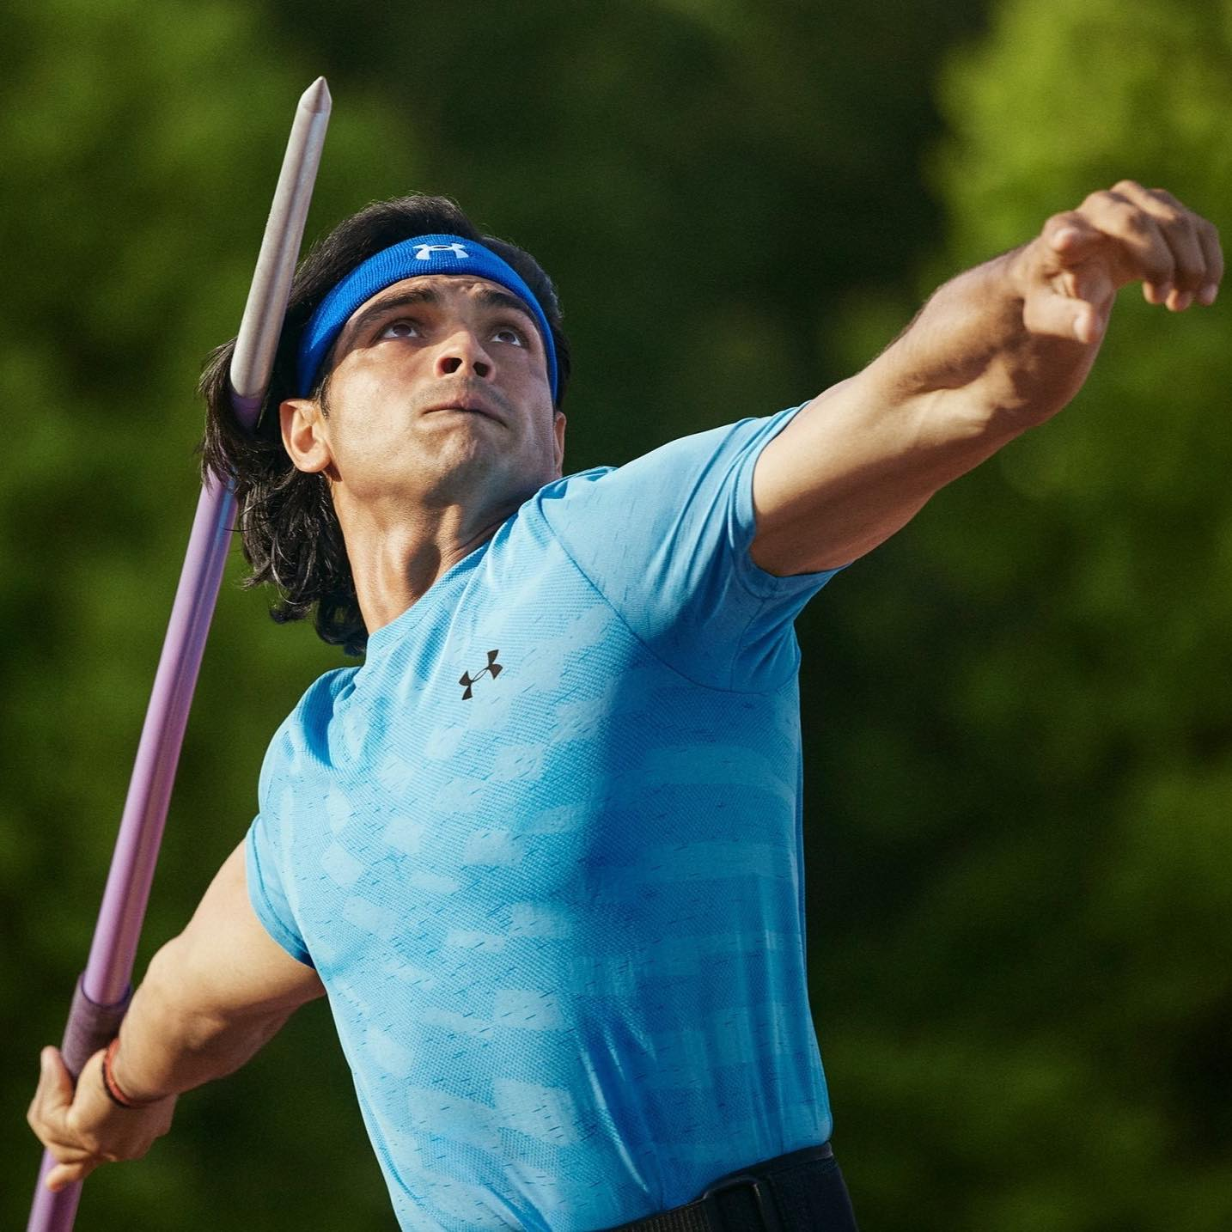
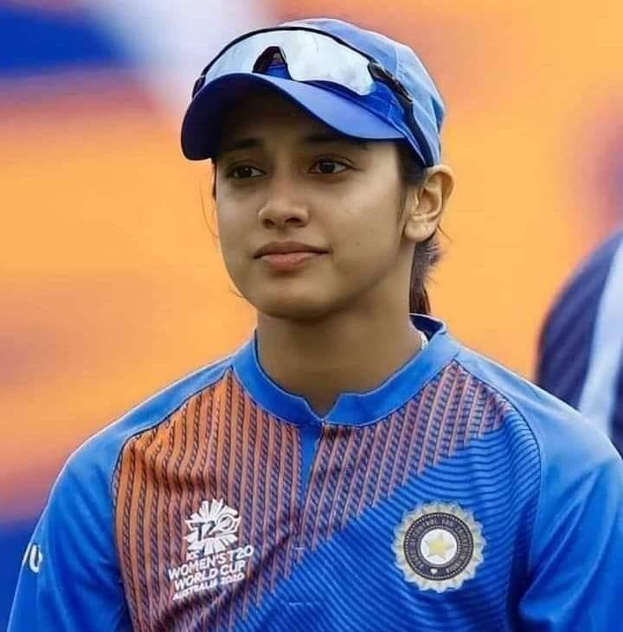
Who can be a brand ambassador, and why?
The ideal brand ambassador for our energy drink is someone who embodies energy, vitality, and authenticity, while also possessing the reach, influence, and relevance to effectively connect with the target audience and drive brand engagement and loyalty.
Neeraj Chopra: A javelin thrower who won a gold medal at the 2020 Tokyo Olympics, Neeraj is one of India's most promising track and field athletes.
Smriti Mandhana: Renowned Indian cricketer, ICC Women's Player of the Year nominee, record-breaking batswoman, and trailblazer for women's cricket

Slide 37

Who should be our target audience, and why?
Our target audience should be youth of age group 15-30 as 70% of respondents fall in that age group.
Our target audience should primarily consist of sportspersons, fitness enthusiasts and individuals who work in offices and students who are night owl’s.
As most of our customers buy our product in supermarkets we should target them by giving discounts and promotional offers.

Slide 38
Recommendations
Effective Marketing & Sponsorship:
Invest heavily in marketing and sponsorship activities to build brand awareness and engagement. Sponsor athletes, sports events, gaming tournaments, music festivals, and other cultural initiatives, positioning ourselves as a lifestyle brand that aligns with the interests and passions of our target demographic i.e young people in the age group of 15-30.
Limited edition packaging:
Creates a sense of scarcity and urgency, Generates excitement and buzz, and promotes collectability which may increase sales as 40% of respondents voted in favor of limited edition packaging.
Brand Identity & Image :
We should cultivate a distinct brand identity as the survey says 25% of respondents prefer a brand over others because of brand reputation. As Nowadays people are becoming health-conscious, we can market ourselves as a healthier alternative to other brands by reducing sugar content and adding more vitamins.

Slide 39
Recommendations
Affordability:
position our brand as a more affordable alternative to established brands like Red Bull. This pricing strategy appealed to cost-conscious consumers, especially in a price-sensitive market like India. Preferred price range is 50-100 Rupees.
Localized Marketing:
adopt a marketing strategy to resonate with Indian consumers. This included localized advertising campaigns, celebrity endorsements, and sponsorships of events like IPL and activities that are relevant to the Indian audience.
Distribution Strategy:
focus on expanding our distribution network across India, making its products widely available in urban i.e both Tier-1 and Tier-2 cities and rural areas alike. This increased accessibility will help drive visibility and sales of our product.

Slide 40
Recommendations
Product Differentiation:
While our brand shares similarities with other energy drinks in terms of ingredients and functionality, we should differentiate ourselves through branding, packaging, and flavor varieties that appeal to Indian tastes and preferences. More caffeine and vitamins are should be added while reducing the sugar content.
Word of Mouth:
Since our product only has 22% positive brand perception, Positive word-of-mouth recommendations and endorsements from satisfied consumers help spread awareness of our energy drink in India. As more people try and like the product, its popularity will grow rapidly.
Expanding Portfolio:
Diversify our product portfolio to include various flavor variants and packaging sizes to cater to different consumer preferences and occasions. This expanded range of options will contribute to its popularity among a wider audience.

Slide 41
Redbull case study
Through sponsorship of athletes, sports teams and investment in own media production they engaged with customer in a deeper way than traditional advertising ever could.
Redbull outsourced production and filling of cans and focus mainly on marketing.
Focus on night clubs and music festivals using student brand managers who are popular university students encouraged to promote redbull on university campuses and throw parties at different locations, supplied entirely by Redbull.
spent almost a third of the budget on marketing as selling an energy drink is hard compared to its production.

Slide 42


